Slide 1


Expand your global reach for less
With UPS Worldwide Economy

Slide 2
E-commerce is growing
But consumers are more price-sensitive.
The global B2C cross-border e-commerce market is expected to reach a value of
€7.3 trillion by 2030
Cost-conscious buyers will often accept a longer delivery time in return for cheaper shipping costs.
Buyers are willing to wait up to 6 days for
non-urgent international purchases
¹ Statista https://www.statista.com/statistics/1296796/global-cross-border-ecommerce-market-value/; ² UPS Voice of the Online Shopper study 2019
3 Globalfy Flow Cross-Border E-Commerce Consumer Report

Slide 3

Expand your global reach for less
UPS Worldwide Economy is our low-cost solution for your global ecommerce shipments.
Ideal for your low-weight (up to 5kg), low-value cross-border shipments
Choose who pays duty fees: Delivery Duties Paid (DDP) or Delivery Duties Unpaid (DDU)
Time in transit to the US 5-8 days (DDP) or 5-12 days (DDU)*
Currently available for businesses in the UK, France, Germany, Italy, Spain, Belgium, the Netherlands and Poland
*Does not include the first leg of transportation to the export site (~2 business days)

Slide 4
Expand your global reach for less
NEW Benefits for you and your customers
27+ global destinations
Fewer surcharges
Enhanced tracking and visibility

Slide 5
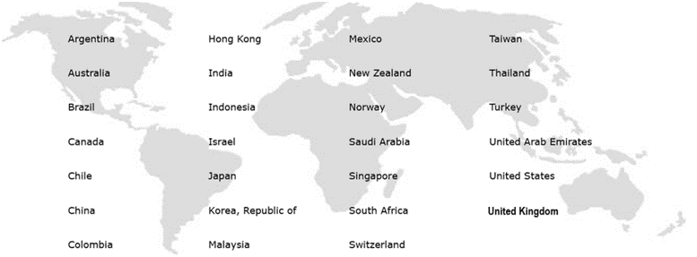
Expand your global reach for less
27+ global destinations
UK businesses can also use this service to deliver to countries in the European Union.

Slide 6

Worldwide Economy Destinations from the GB/UK
DDU USA currently suspended (Relaunching soon). Currently, impacts are across Middle Eastern countries due to geopolitical conflicts.
DDP – Service to 51 Countries
US & Americas
EMEAI
Asia Pacific
Argentina
Brazil
Chile
Colombia
Mexico
Canada
United States¹
United Arab Emirates | France | Netherlands
Austria | Greece | Norway
Belgium | Croatia | Poland
Bulgaria | Hungary | Portugal
Switzerland | Ireland | Romania
Czech Republic | Israel | Saudi Arabia
Germany | India | Sweden
Denmark | Italy | Slovenia
Estonia | Lithuania | Slovakia
Spain | Luxembourg | Turkey
Finland | Latvia | South Africa
Australia
China
Hong Kong
Indonesia
Japan
South Korea
Malaysia
New Zealand
Singapore
Thailand
Taiwan
DDU – Available to 115 Countries & Territories.
¹ Limited to the US 48 contiguous states only. No AK, HI or US Territories
Notes:
Script:
From the UK, Worldwide Economy DDP is available to 51 countries and offers end-to-end tracking. DDU is available to 115 countries and territories with tracking generally offered up to the point of postal induction in the destination country. The exception to this being DDU shipments to the US which are tracked all the way to delivery.
Please note that for DDP opportunities greater than 250 ADV, you will need to contact Worldwide Economy Operations to confirm no constraints exist for the customer’s targeted lanes.

Slide 7
Worldwide Economy Destinations from the EU
DDU USA currently suspended (Relaunching soon). Currently, impacts are across Middle Eastern countries due to geopolitical conflicts.
DDP – Service to 29 Countries
US & Americas
EMEAI
Asia Pacific
Argentina
Brazil
Canada
Chile
Colombia
Mexico
United States¹
United Arab Emirates | Jersey
Switzerland | Norway
United Kingdom | Saudi Arabia
Guernsey | Turkey
Israel | South Africa
India
Australia | Malaysia
China | New Zealand
Hong Kong | Singapore
Indonesia | Thailand
Japan | Taiwan
South Korea
DDU – Service to 91 Countries & Territories
¹ Limited to the US 48 contiguous states only. No AK, HI or US Territories
Notes:
Script:
From the EU, Worldwide Economy DDP is available to 29 countries and offers end-to-end tracking. DDU is available to 91 countries and territories with tracking generally offered up to the point of postal induction in the destination country. The exception to this being DDU shipments to the US which are tracked all the way to delivery.
Similar to what was communicated on the prior slide, you will need to contact Worldwide Economy Operations regarding DDP opportunities greater than 250 ADV. They can confirm that no constraints exist for the customer’s targeted lanes.

Slide 8
Expand your global reach for less
Fewer surcharges
Fees and surcharges* | UPS Express | UPS Economy DDP | UPS Economy DDU
Demand surcharge | √ | × | ×
Residential Surcharge | √ | × | ×
Fuel Surcharge | √ | √ 5% | ×
Disbursement Fee | √ | × | ×
Free Domicile Fee | √ | × | ×
Dimensional Weight | √ | √ | ×**
Please note, UPS Economy DDP has a fixed 5% Fuel Surcharge.
    * Other surcharges may also apply. For more information, visit ups.com
    ** Packages destined to the United States larger than one cubic foot will be charged the greater of actual weight or dimensional weight using the formula of (Length x Width x Height) / 5000.

Slide 9
Other surcharges that might apply to your parcel
This is a limited of view of general accessorial charges that might apply to parcels,
any others will depend on the nature of your shipment
Charges | Aligns to Small Package Daily Rates | Applies to: (DDP/DDU/BOTH) | Description
Address Correction | Yes | BOTH | If any shipment has an incorrect or incomplete address, UPS will make reasonable efforts to secure the correct or complete address and will make available to the shipper the correct address. UPS may also correct or complete an address based on information obtained from the shipper or consignee. An Address Correction charge will be assessed to the shipper for an address correction or completion. – An address validated by UPS may be incorrect or incomplete for purposes of completing delivery and may be corrected by UPS.
Add’l Handling | Yes | DDP | An Additional Handling charge will be assessed for any package that requires special handling, as determined by UPS in its sole discretion, including, but not limited to: Weight, Length, Length + girth, width, packaging/other
Lookup Surcharge / Missing or Invalid Acct Number or Refusal Fee | Yes | BOTH | A processing fee will be charged for a missing or invalid when the account number is missing, the acct number is not the correct number for the bill-to party, the acct number is for a receiver or third party who fails to pay the shipping charges, or package is shipped to an unauthorized consignee.
Large Package Surcharge | Yes | BOTH | Packaging materials need to be evaluated carefully for packages weighing more than 70 pounds (40kg) OR when its Length (longest side of the package) plus Girth [(2 x Width) + (2 x Height)] combined exceeds 130 inches.
Chargeback Fee | No | DDP | In the event of non-payment by the consignee or third party, the original shipper will be billed a refusal fee in addition to shipping charges
Third Party Billing Service Fee | Yes | BOTH | A fee applies to any shipment billed to a third party (regardless of the country of origin or destination of the shipment) and will be charged to the payer
Data Entry Fee | No | BOTH | All pieces received that require manual data entry for electronic transmission purposes in the event the customer does not transmit data through an End of Day process or an approved shipping system, or if a Worldwide Economy label is missing.
Other Gov’t Dept (Also known as PGA / OGA) | No | DDP | Applies to DDP packages only. A fee applies to each package exported to Canada or United States that requires other government department (“OGD”) clearance, including but not limited to those subject to U.S. Food & Drug Administration, U.S. Dept of Agriculture, and Canadian Food Inspection Agency import requirements
High Value Threshold | No | DDP | The fee will be applied to a package if the package value exceeds the High Value Customs Clearance Fee Threshold in the associated currency listed in the table in the following pages
Peak Demand Surcharges | No | BOTH | Peak
Peak Add’l Handling | No | DDP | Peak
Peak Large Package | No | DDP | Peak

Slide 10
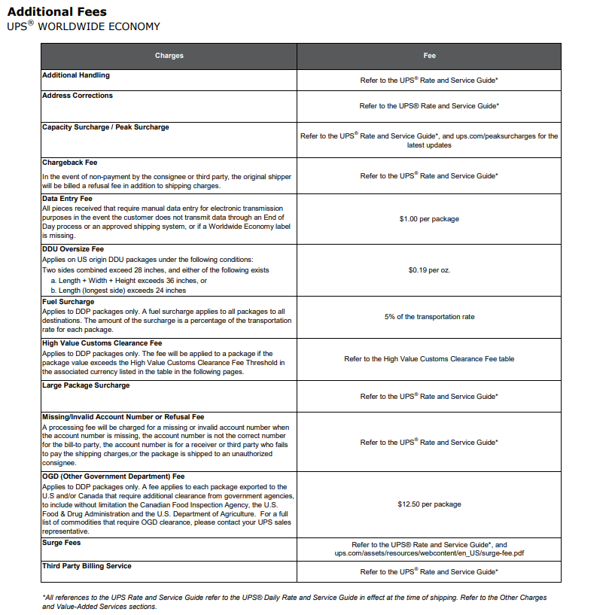
UPS WW Economy Accessorial Fees
As listed on US Service Guides

Slide 11
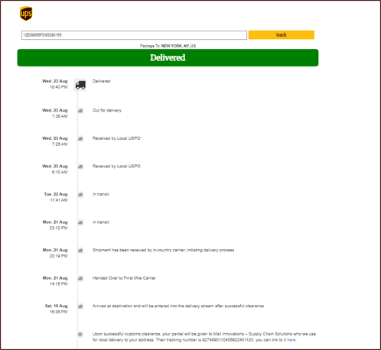
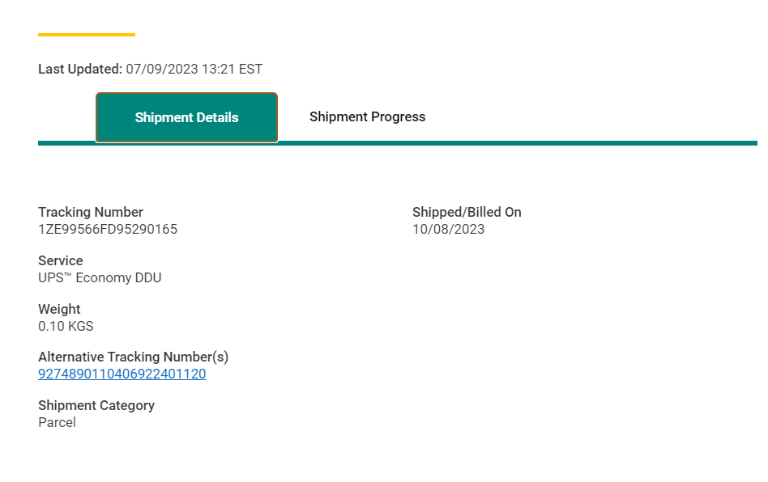
Expand your global reach for less
Enhanced tracking and visibility
With UPS Economy, your customers will benefit from end-to-end tracking and comprehensive notifications, reducing the number of customer enquiries you receive.*
*All countries for UPS Economy DDP, selected countries
for UPS Economy DDU

Slide 12
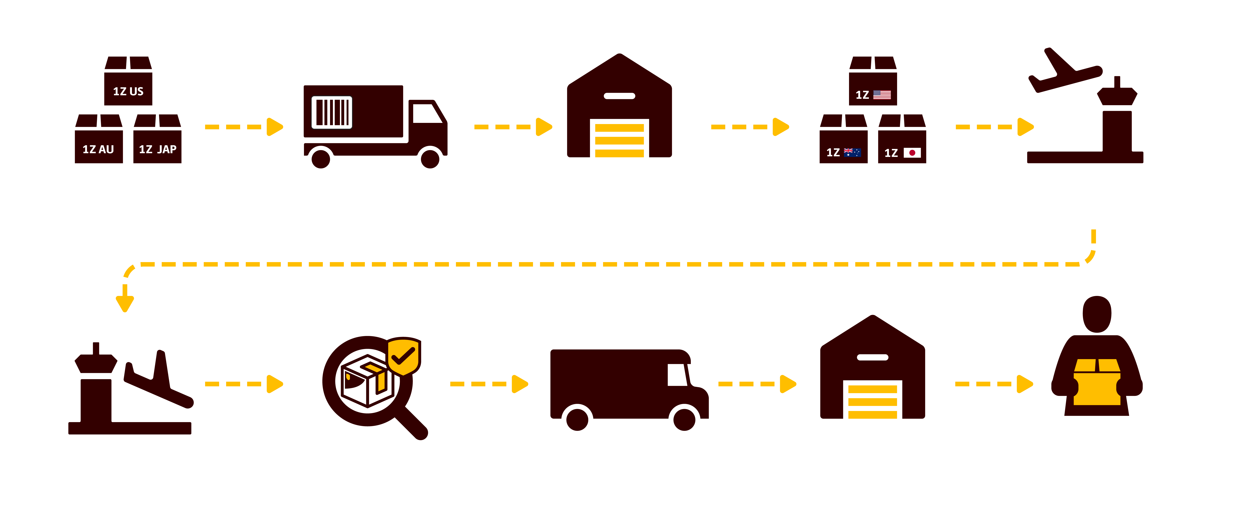

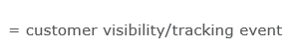
Expand your global reach for less
How does it work?
Label
Created
Transport to
export site
Arrival at
export site
Re-labeled
for destination
Exported
Arrival -
Destination country
Release /
Customs clearance
Package
in transit
Received at
Delivery Center
Package
Delivered

Slide 13
Expand your global reach for less
How does it work?
Step 1
Parcels will be labelled with UPS Worldwide Economy 1Z labels indicating the final destination.
Each child parcel can be shipped as an individual parcel with UPS Worldwide Economy.
Step 2
Parcels with UPS Worldwide Economy labels are picked up by a UPS driver and delivered to the export site.
Step 3
At the export site, the parcels are separated by destination and re-labelled for international shipping with an alternate tracking label and number.
Step 4
The parcels are flown to their destination countries and will go through customs clearance.
Step 5
Once parcels are cleared by customs, they will be delivered to your final recipient.

Slide 14

Expand your global reach for less
Important to know
  Ways of getting your parcels to the UPS Economy export site
  If you choose UPS to transport your Economy parcels to the designated UPS Economy export site, simply book a normal UPS collection and the driver will collect your packages and take them to the export site. Door to door rates will be applicable.
  If you would like drop off your Economy parcels directly to the designated UPS Economy export site, this is also permitted and you can ask your sales manager for exclusive Airport to door rates.

Slide 15

Expand your global reach for less
Important to know
  Actual vs dimensional weight
  UPS Economy DDP
  Packages will be charged whatever is the greater of actual weight or dimensional weight using the formula (Length x Width x Height) / 5000 metric kg.
  UPS Economy DDU
  Packages will be charged on actual weight unless they are destined for the US:
    Packages with dimensions (Length x Width x Height) less than one cubic foot (28,316 cubic centimeters) will be charged on actual weight.
    Packages larger than one cubic foot will be charged whatever is the greater of actual weight or dimensional weight using the formula (Length x Width x Height) / 5000 metric kg.

Slide 16
Expand your global reach for less
Important to know
Prohibited items
Dangerous goods, e.g., compressed gases or flammable liquids
Weapons
Tobacco products
Perishables, e.g., fresh fruit
Bulk shipments intended for resale (B2B shipments)*
Animal byproducts, e.g., alligator leather or feather pillows*
Plant byproducts, e.g., flowers, rocks, soil samples*
Refurbished or used merchandise, e.g., repaired electronics, used car parts*
*Prohibited using UPS Economy DDP only. Also included in Service T’s&C’s.
This is not an exhaustive list. Please contact your account manager to verify if your product is allowed to be sent via UPS Economy.

Slide 17

Safeguarding your
US shipments
With
UPS® Worldwide Economy DDP

Slide 18
How your business can mitigate the impact of US regulatory change
Switch your shipping method to Delivered Duty Paid (DDP)
DDP offers significant advantages for both you and your customers, such as:
Predictable costs - duties and taxes are paid upfront, so your customers see one clear price.
Fewer returns – transparent pricing reduces the risk of refused shipments and ensures a better delivery experience.
Simplified customs clearance – keeping your business compliant whilst reducing risk of customs delays and any unforeseen penalties.
* Business Days

Slide 19
Expand your global reach for less with UPS Economy

Slide 20
UPS WW Economy Contact List
Important to know
Self Service Worldwide Economy Resources
Questions about a package - Submit inquiry through https://tracking.wweconomy.ups.com/ContactUs/ContactUs
API Support: email uoltects@ups.com; or call +1(800) 247-9035
External (customer-facing)

